Slide 1

Abstraction
Algorithms

Slide 2
Definisi
Abstraction is the purposeful suppression, or hiding, of some details of a process or artifact, in order to bring out more clearly other aspects, details, or structure.
Abstraksi adalah penekanan, atau penyembunyian, beberapa detail suatu proses atau artefak dengan sengaja, untuk menonjolkan aspek, detail, atau struktur lainnya dengan lebih jelas.

Slide 3
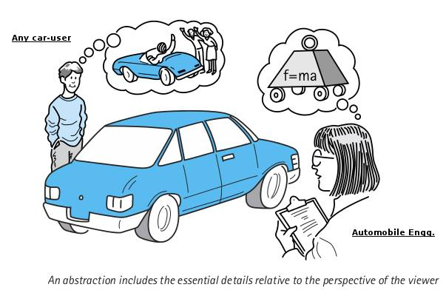
Definisi

Slide 4
Definisi
Abs
(away from)
Trahere
(to draw)
Abstraction
Process of taking away or removing characteristics from something in order to reduce it to a set of essential characteristics.

Slide 5
Information Hiding
Information hiding is the purposeful omission of details in the development of an abstract representation.
Information hiding is what allows abstraction to control complexity.

Slide 6
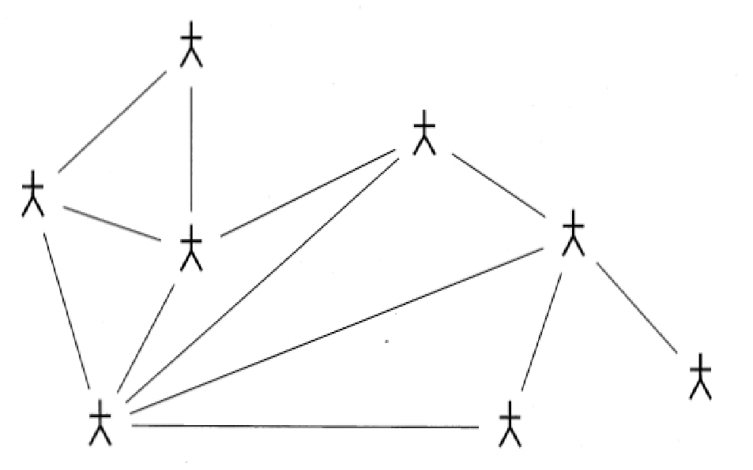
Levels of Abstraction in OO Programs
At the highest level of abstraction, we view a program as a community of interacting objects.
Important characteristics here are the lines of communication between the various agents.

Slide 7
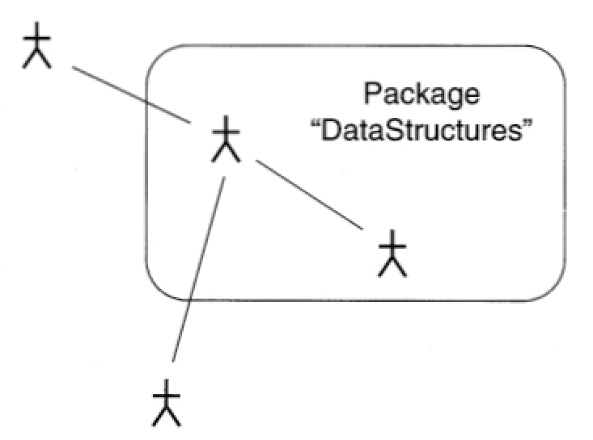
Abstraction in OO Programs, Packages and Name spaces
The next level of abstraction is found in some (but not all) OO languages. A package, Unit or Name Space allows a programmer to surround a collection of objects (a small community in itself) with a layer, and control visibility from outside the module.

Slide 8
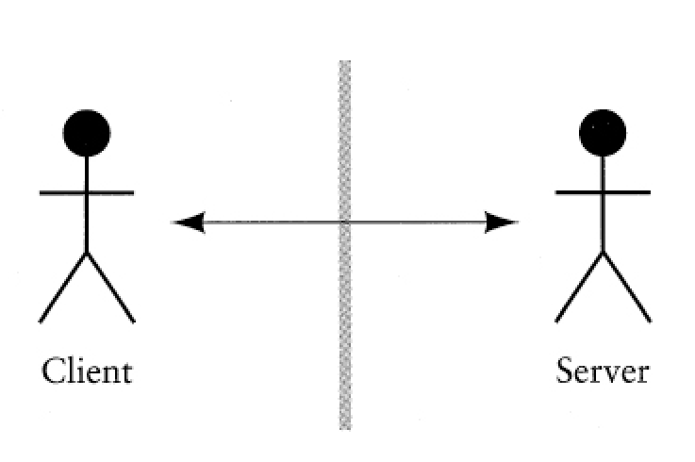
Abstraction in OO Languages, Clients and Servers
The next level of abstraction considers the relationship between two individual objects. Typically, one is providing a service, and the other is using the service.

Slide 9
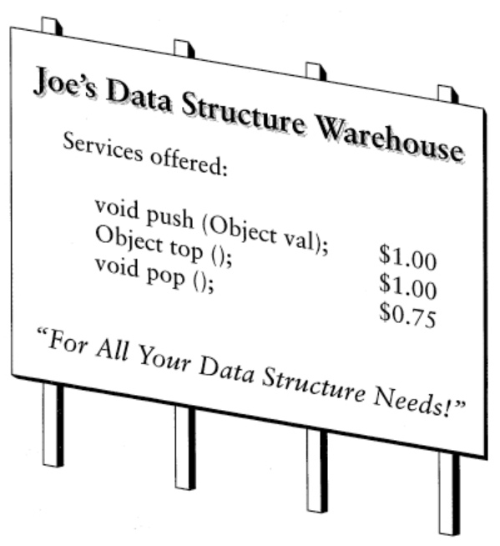
Abstraction in OO Languages, Description of Services
We can next examine just the person providing a service, independent of the client. We define the nature of the services that are offered, but not how those services are realized.

Slide 10
Other Types of Abstraction Composition
While is-a and has-a are two important types of abstraction, there are others.
Composition is one example; a form of has-a; characterized by the following
Primitive forms
Rules for combining old values to create new values
The idea that new values can also be subject to further combination
Examples include regular expressions, type systems, windows, lots of other complex systems.

Slide 11
Is-a and Has-A abstraction
Two of the most important types of abstraction are the following:
Division into parts -- Has-a abstraction
Division into specialization -- Is-a abstraction

Slide 12
Has-A Abstraction
Division into parts takes a complex system, and divides into into component parts, which can then be considered in isolation.
Characterized by sentences that have the words ``has-a''
A car has-a engine, and has-a transmission
A bicycle has-a wheel
A window has-a menu bar
Allows us to drop down a level of complexity when we consider the component in isolation.

Slide 13
Is-a Abstraction
Is-a abstraction takes a complex system, and views it as an instance of a more general abstraction.
Characterized by sentences that have the words ``is=a''
A car is a wheeled vehicle, which is-a means of transportation
A bicycle is-a wheeled vehicle
A pack horse is-a means of transportation
Allows us to categorize artifacts and information and make it applicable to many different situations.

Slide 14
Encapsulation and Interchangeability
An important aspect of division into parts is to clearly characterize the connection, or interface, between to components.
Allows for considering multiple different implementations of the same interface.
For example, a car can have several different types of engine and one transmission.

Slide 15
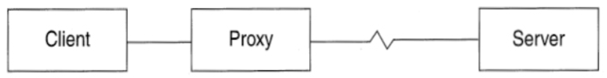
Patterns
Patterns are another attempt to document and reuse abstractions.
Patterns are description of proven and useful relationships between objects; which can help guide the solution of new problems.
Example pattern, Proxy:

Slide 16
Programming in the Small and Programming in the Large
Programming in the Small:
One programmer, understands everything from top to bottom.
Major problem is the development of algorithms.
Programming in the Large:
System is developed by large team of programmers
Major problems are management of details and communication between programmers and between their respective software subsystems.

Slide 17
Basis for Design
Consider for the moment what aspects of a problem are known first:
Data Structures
Functions
A Formal Specification
Behavior
A design technique based on behavior can be applied from the very beginning of a problem, whereas techniques based on more structural properties necessarily require more preliminary analysis.

Slide 18
Responsibility Driven Design
A design technique that has the following properties:
Can deal with ambiguous and incomplete specifications.
Naturally flows from Analysis to Solution.
Easily integrates with various aspects of software development.

Slide 19
Directed Evolution
Let us take specifications as they occur in nature
Imprecise
Ambiguous
Unclear
and rather than attempt to change human nature, let us direct the evolution of the specification in concert with the design of the software system.

Slide 20
An Example, the IIKH
Imagine you are the chief software architect in a major computing firm.
The president of the firm rushes into your office with a specification for the next PC-based product. It is drawn on the back of a dinner napkin.
Briefly, the Intelligent Interactive Kitchen Helper will replace the box of index cards of recipes in the average kitchen.

Slide 21
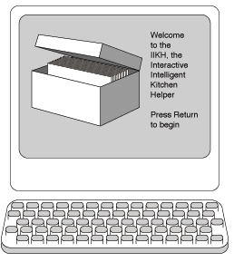
The IIKH
Here are some of the things a user can do with the IIKH:
Browse a database of recipes
Add a new recipe to the database
Edit or annotate an existing recipe
Plan a meal consisting of several courses
Scale a recipe for some number of users
Plan a longer period, say a week
Generate a grocery list that includes all the items in all the menus for a period

Slide 22
Characterization by Behavior
Just as an Abstract Data Type is characterized more by behavior than by representation, the goal in using Responsibility Driven Design will be to first characterize the application by behavior.
First capture the behavior of the entire application.
Refine this into behavioral descriptions of subsystems.
Refine behavior descriptions into code.
This emphasis on behavior is a hallmark of Object-Oriented programming.

Slide 23
Working Through Scenarios
Because of the ambiguity in the specification, the major tool we will use to uncover the desired behavior is to walk through application scenarios.
Pretend we had already a working application. Walk through the various uses of the system.
Establish the ``look and feel'' of the system.
Make sure we have uncovered all the intended uses.
Develop descriptive documentation.
Create the high level software design.

Slide 24
Software Components
A software component is simply an abstract design entity with which we can associate responsibilities for different tasks.
May eventually be turned into a class, a function, a module, or something else.
A component must have a small well-defined set of responsibilities
A component should interact with other components to the minimal extent possible

Slide 25
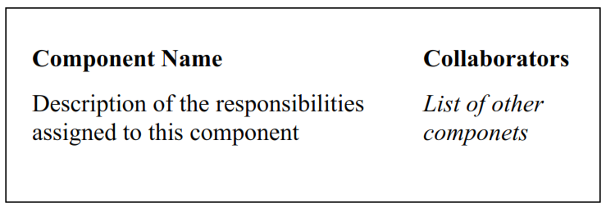
CRC Cards
Components are most easily described using CRC cards. A CRC card records the name, responsibilities, and collaborators of an component.

Slide 26
The first component, The Greeter
When the application is started, the Greeter puts an informative and friendly welcome window (the greeting) on the screen.
Offer the user the choice of several different actions
Casually browse the database of recipes.
Add a new recipe.
Edit or annotate a recipe.
Review a plan for several meals.
Create a plan of meals.

Slide 27
The Recipe Database Component
Ignoring the planning of meals for the moment, your team elects to next explore the recipe database component.
Must Maintain the Database of recipes.
Must Allow the user to browse the database.
Must permit the user to edit or annotate an existing recipe.
Must permit the user to add a new recipe.

Slide 28
The Who/What Cycle
As we walk through scenarios, we go through cycles of identifying a what, followed by a who
What action needs to be performed at this moment,
Who is the component charged with performing the action
Every what must have a who, otherwise it simply will not happen. Sometimes the who might not be obvious at first, i.e., who should be in charge of editing a recipe?

Slide 29
Postponing Decisions
Many decisions, such as the method of browsing, can be ignored for the moment, as they are entirely encapsulated within the recipe database component, and do not effect other components.
Scroll bars and windows?
A virtual ``book'' with thumb-holes and flipping pages?
Keywords and phrases?
Only need to note that somehow the user can manipulate the database to select a specific recipe.

Slide 30
Responsibilities of a Recipe
We make the recipe itself into an active data structure. It maintains information, but also performs tasks.
Maintains the list of ingredients and transformation algorithm.
Must know how to edit these data values.
Must know how to interactively display itself on the output device.
Must know how to print itself.
We will add other actions later (ability to scale itself, produce integrate ingredients into a grocery list, and so on).

Slide 31
The Planner Component
Returning to the greeter, we start a different scenario. This leads to the description of the Planner.
Permits the user to select a sequence of dates for planning.
Permits the user to edit an existing plan.
Associates with Date object.

Slide 32
The Date Component
The Date component holds a sequence of meals for an individual date.
User can edit specific meals.
User can annotate information about dates (''Bob's Birthday'', ``Christmas Dinner'', and so on).
Can print out grocery list for entire set of meals.

Slide 33
The Meal Component
The Meal component holds information about a single meal.
Allows user to interact with the recipe database to select individual recipes for meals.
User sets number of people to be present at meal, recipes are automatically scaled.
Can produce grocery list for entire meal, by combining grocery lists from individual scaled recipes.

Slide 34
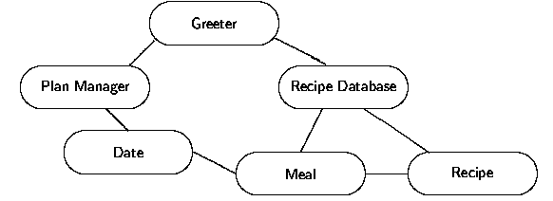
The Six Components

Slide 35
Characteristics of Components
Let us return to the idea of a software component.
There are many different aspects to this simple idea, we will consider just a few:
Behavior and State
Instances and Classes
Coupling and Cohesion
Interface and Implementation

Slide 36
Behavior and State
All components can be characterized by two aspects:
The behavior of a component is the set of actions a component can perform. The complete set of behavior for a component is sometimes called the protocol.
The state of a component represents all the information (data values) held within a component.
Notice that it is common for behavior to change state. For example, the edit behavior of a recipe may change the preparation instructions, which is part of the state.

Slide 37
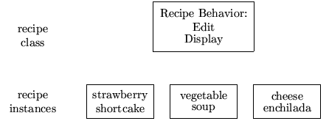
Instances and Classes
We can now clarify a point we earlier ignored. There are likely many instances of recipe, but they will all behave in the same way. We say the behavior is common to the class Recipe.

Slide 38
Coupling and Cohesion
The separation of tasks into the domains of different components should be guided by the concepts of coupling and cohesion.
Cohesion is the degree to which the tasks assigned to a component seem to form a meaningful unit. Want to maximize cohesion.
Coupling is the degree to which the ability to fulfill a certain responsibility depends upon the actions of another component. Want to minimize coupling.

Slide 39
Interface and Implementation
We have characterized software components by what they can do.
The user of a software component need only know what it does, not how it does it.
“Ask not what you can do to a data structure, ask instead what your data structures can do for you”.

Slide 40
Next Step - Formalize the Interface
The next step is to formalize the channels of communication between the components.
The general structure of each component is identified.
Components with only one behavior may be made into functions.
Components with many behaviors are probably more easily implemented as classes.
Names are given to each of the responsibilities - these will eventually be mapped on to procedure names.
Information is assigned to each component and accounted for.
Scenarios are replayed in order to ensure all data is available.

Slide 41
A Rose by any other Name
Government bureaucrats have long shown us that obscure and idiomatic names can make even the simplest operation sound intimidating.
The selection of names is an important task.
Names should be evocative in the context of the problem.
Names should be short.
Names should be pronounceable (read them out load).
Names should be consistent within the project.
Avoid digits within a name.

Slide 42
Tugas
Describe features of the building using the technique of division into parts, followed by a further refinement of each part into a more detailed description. Extend your description to at least three levels of detail.
Describe a collection of everyday objects using the technique of layers of specialization
Create a scenario for a New Student Registration using an interaction diagram.

